Slide 1
The Next 150 Years of Animal Breeding:
A North American Perspective
breed4food Workshop
Thursday, May 2, 2024
John B. Cole
www.uscdcb.com

Slide 2
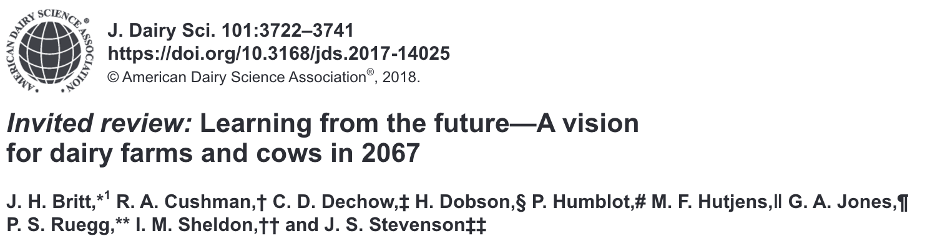
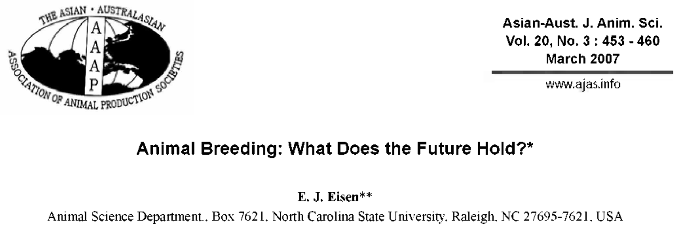
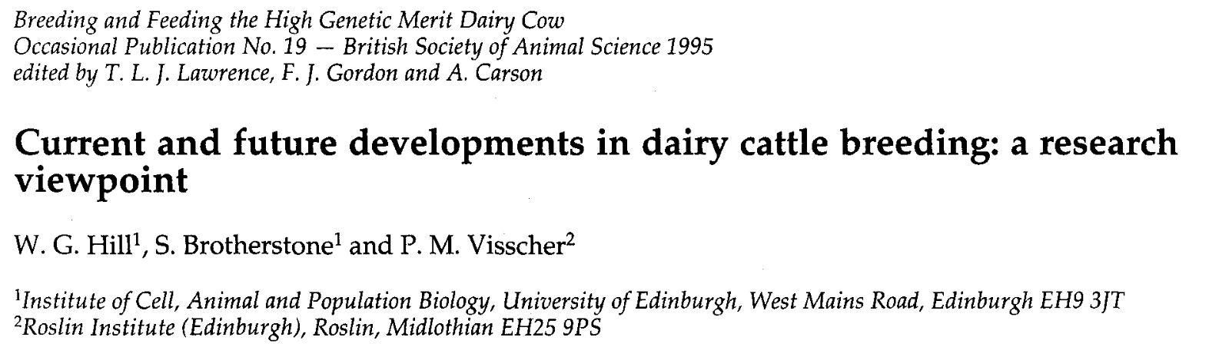
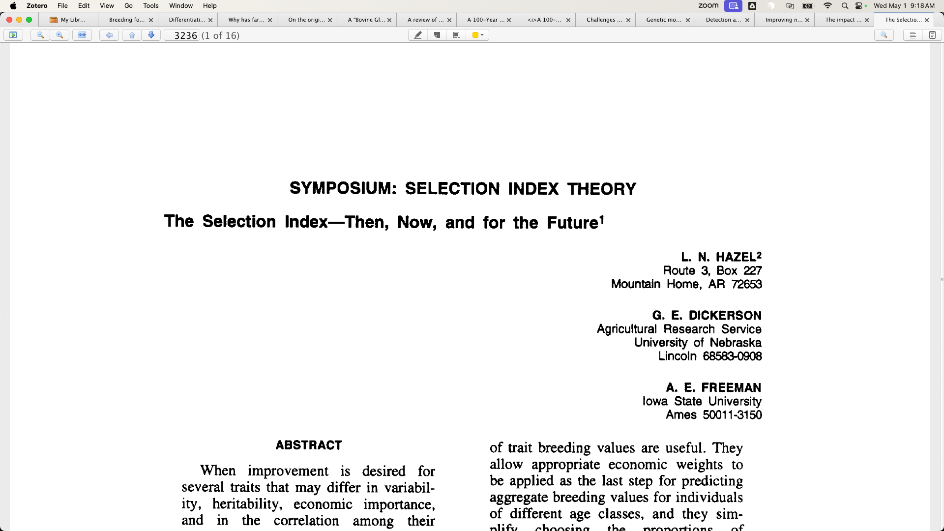
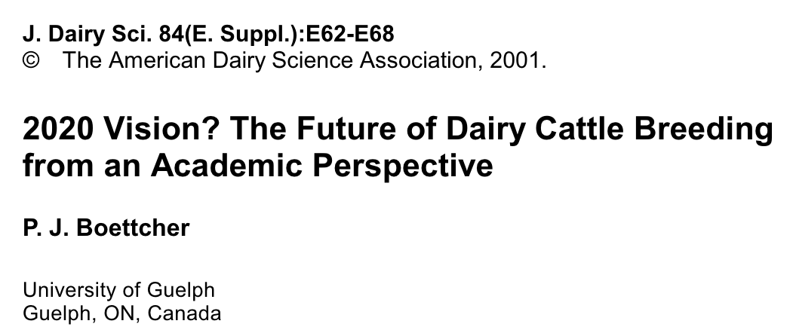
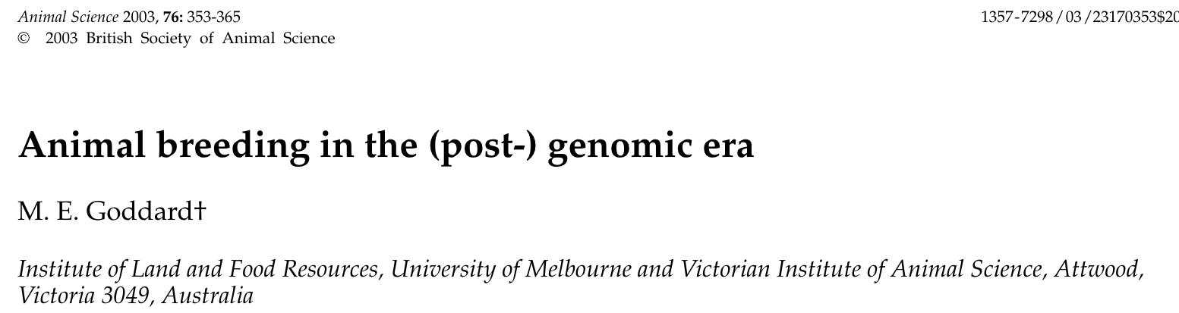
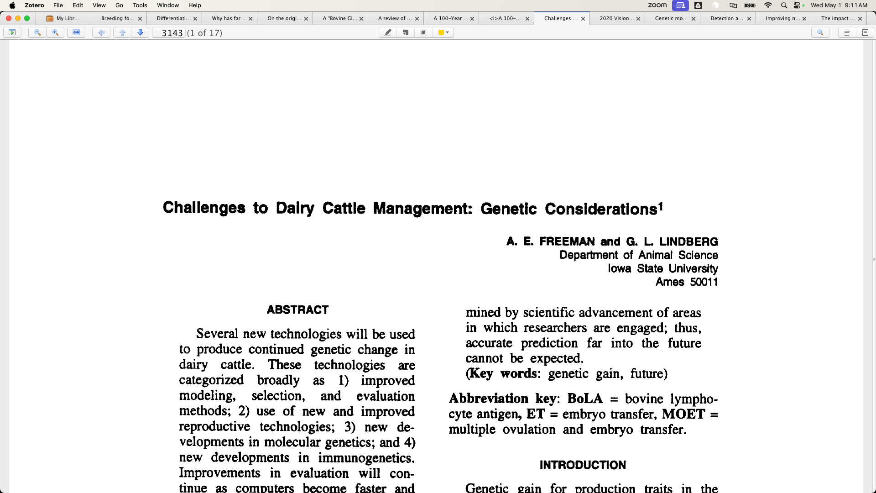
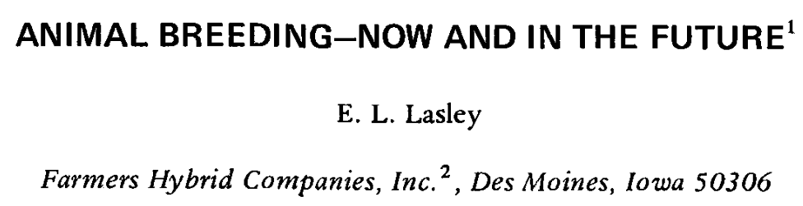
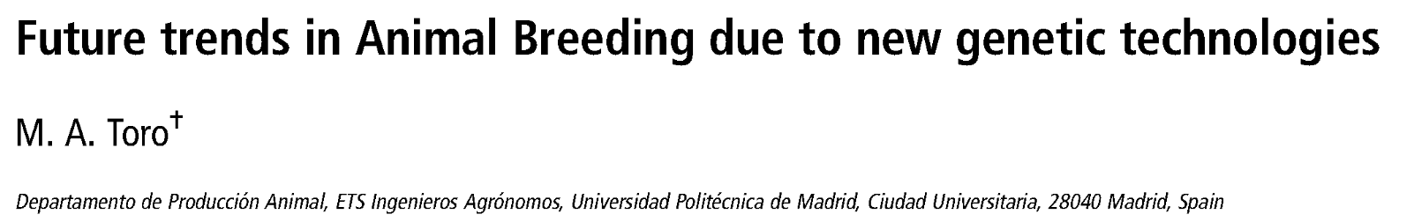
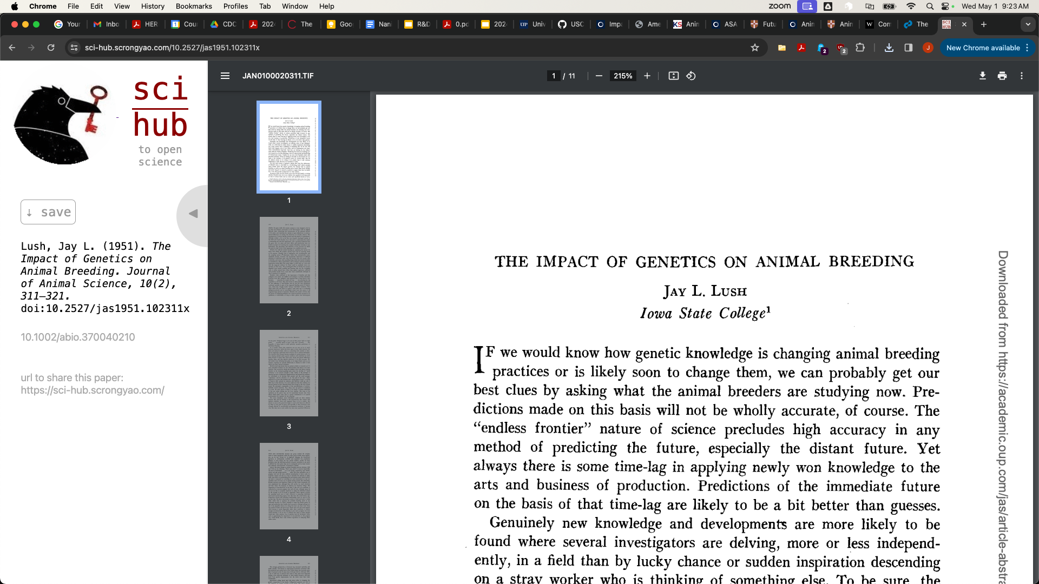
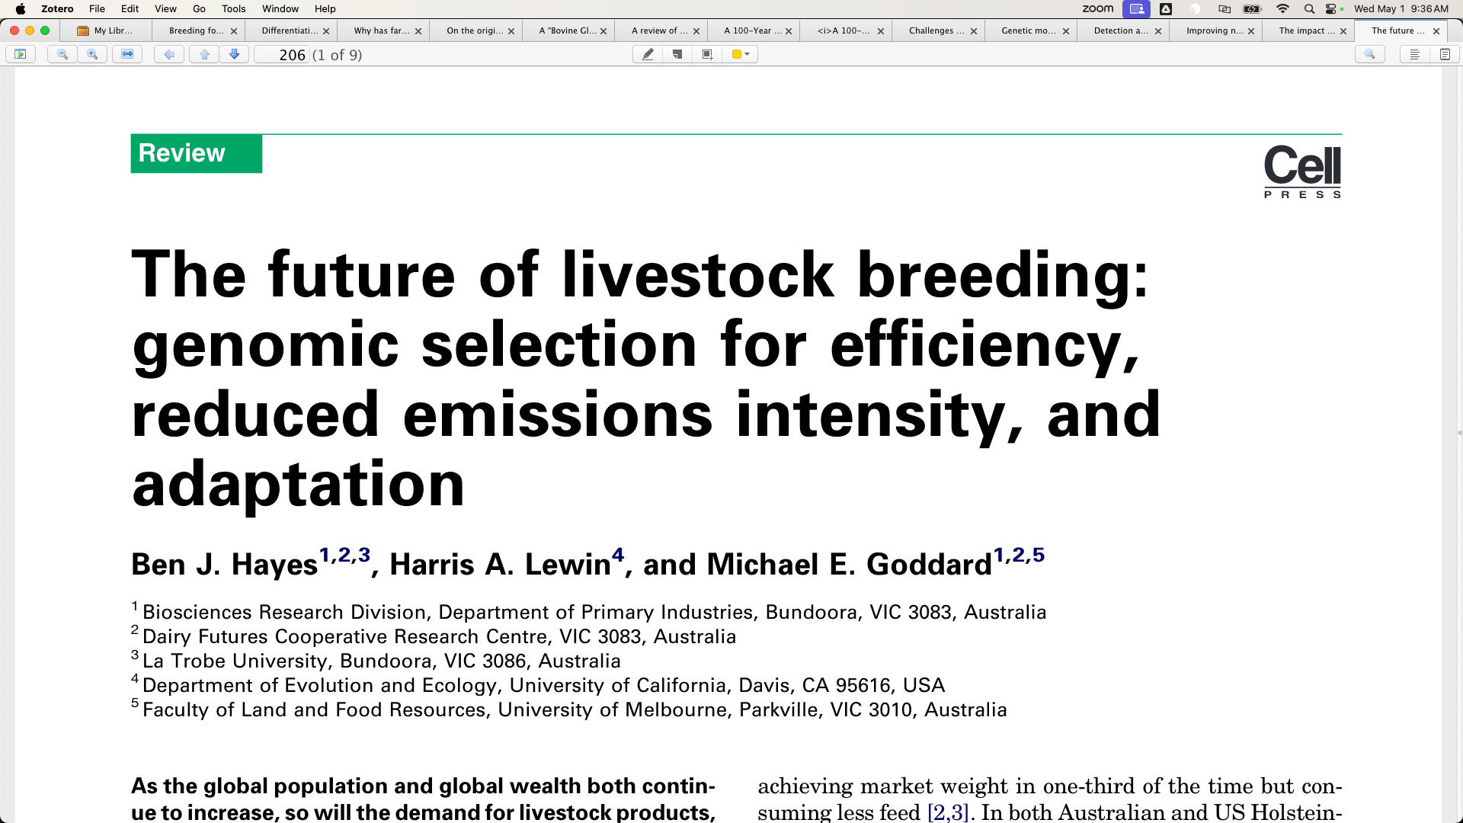
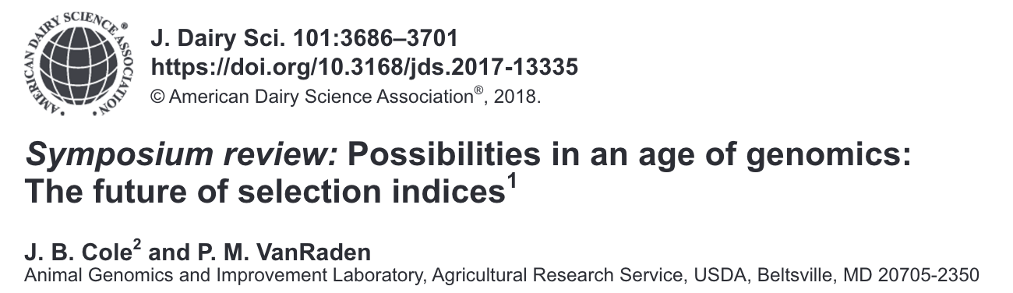
“The future belongs to those who prepare for it today” – Malcolm X
1994
1993
1977
2011
1951
2013
Cole – breed4food – May 2, 2024 - ‹#›

Slide 3
How are we doing?
¹Hodgson (1956)
²CDCB WebConnect (2022)
2,399 lbs.
1890 avg. milk production¹
2022 avg. standardized milk yield (HO)²
28,416 lbs.
!!! DISCLAIMER: many factors have changed in data recording and
standardization over this 130-year period !!!
However, unmistakable progress has been made. How?
Attributed to:
(1) selection &
(2) improving the environment of dairy cows
Cole – breed4food – May 2, 2024 - ‹#›

Slide 4
Difficult Questions
What if data were no longer scarce?
What if bulls were irrelevant?
What if genetic improvement was irrelevant?
What if animals were irrelevant?
What if North America and Europe were irrelevant?
Cole – breed4food – May 2, 2024 - ‹#›

Slide 5
What if data were no longer scarce?
Question 1

Slide 6
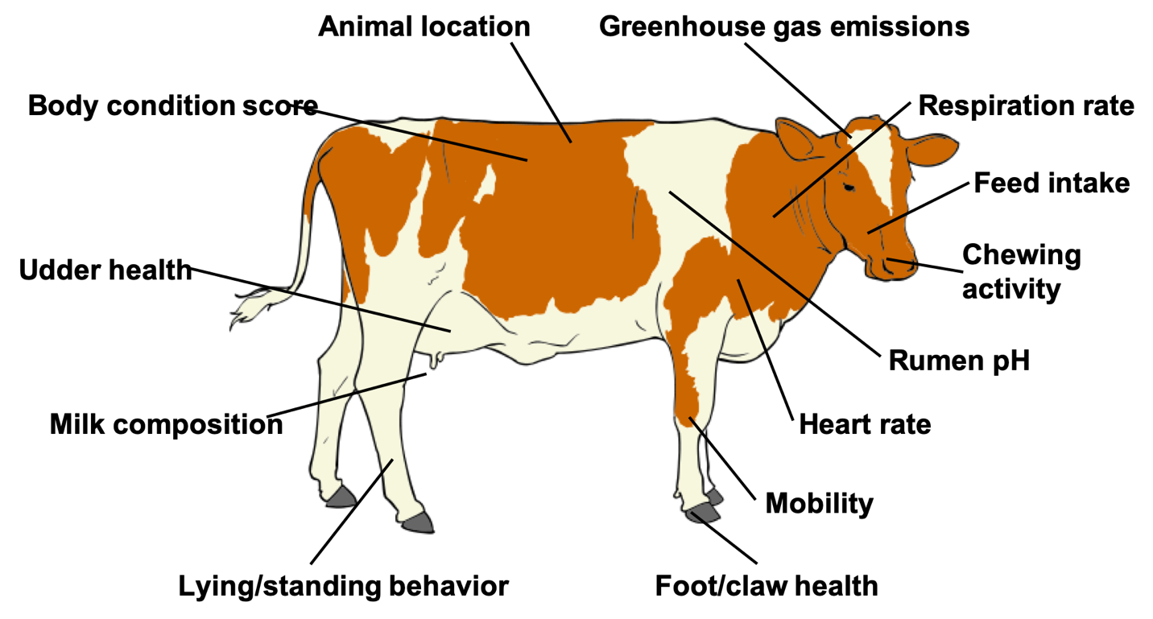

Phenotype is king!
Source: Cole et al. (2020; PMID: 32257602) after Figure 5 of Halachmi et al. (2019, PMID: 30485756).
Cole – breed4food – May 2, 2024 - ‹#›

Slide 7
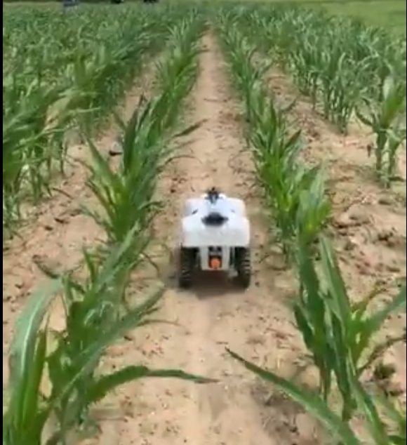

Next-generation automated phenotyping
How it started…
How it’s going…
Source: Aimee Schulz (@aimeejschulz)
Source: Skaro Ministry of Science/BBC One
Cole – breed4food – May 2, 2024 - ‹#›

Slide 8
What are we actually trying to improve?
Feed Intake
Calves produced
CO₂ emission
Lifetime profit
“Efficiency”
Body size
Functional longevity
Live weight
Methane production
Income over feed cost
Mid-infrared milk spectrum
Body condition score
Microbiome
Cole – breed4food – May 2, 2024 - ‹#›

Slide 9
What does this mean for animal breeders?
As phenotyping becomes easier, barriers to entry become lower for genetic improvement programs
European and North American universities have trained many excellent scientists from emerging countries whose impact on their local industries has often been limited by lack of data
Computing requirements could increase, which favors established programs, or could remain modest if genetic rather than genomic evaluations are used to bootstrap a local industry
Cole – breed4food – May 2, 2024 - ‹#›

Slide 10
What if bulls were irrelevant?
Question 2

Slide 11
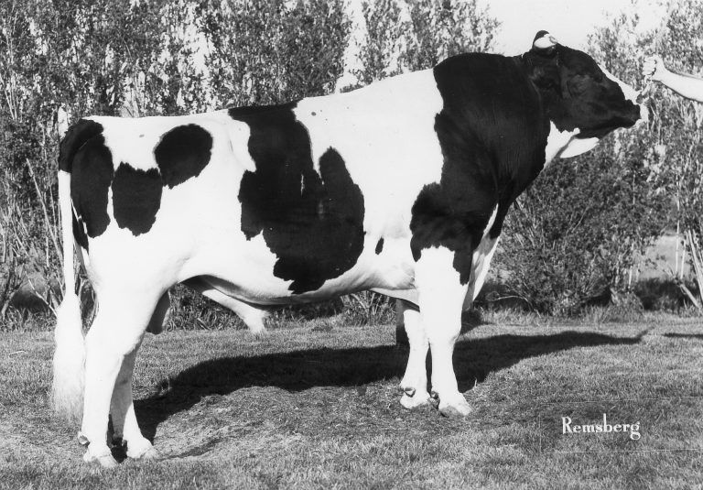
Why do we like bulls?
We know how to create, house, and manage bulls
Semen is easy to collect, package, and distribute
Sorting is a mature technology that enables complex management programs
Cole – breed4food – May 2, 2024 - ‹#›

Slide 12
What do we dislike about bulls?
Bulls are very dangerous to humans
The use of young bulls to drive genetic improvement is very inefficient
Semen is a poorly differentiated, commodity product
It has historically been very difficult to capture the true value of improved genetics in a semen check
Cole – breed4food – May 2, 2024 - ‹#›

Slide 13
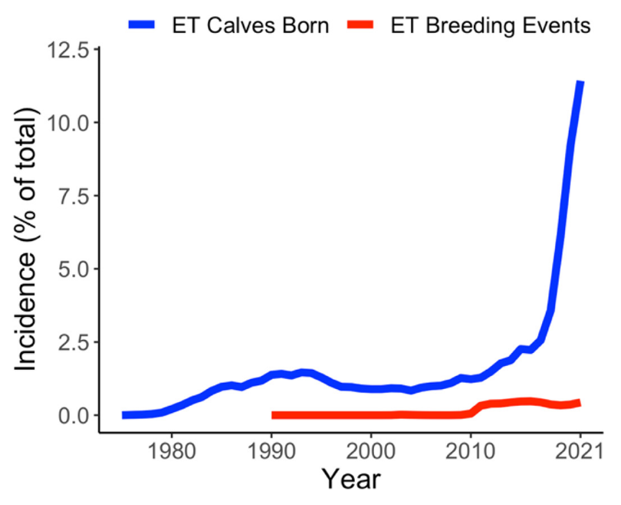
What if we replace semen with embryos?
The # of ET calves born is growing
rapidly
Terminal beef calves are desirable in
beef-on-dairy systems
Costs are high and skilled technicians
are valuable
Source: Miles et al., 2023, https://doi.org/10.3168/jds.2022-22298
Cole – breed4food – May 2, 2024 - ‹#›

Slide 14
What if genetic improvement was irrelevant?
Question 3

Slide 15
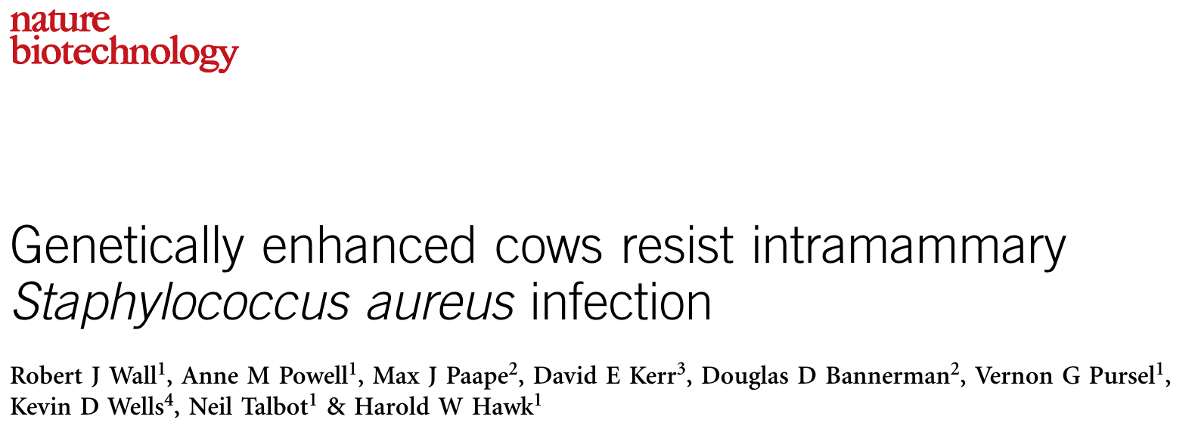
Introducing genes from other species
Many problems have already been solved through evolution
Gene editing may avoid many side- effects of older tools
Source: Wall et al., 2005, https://doi.org/10.1038/nbt1078.
Cole – breed4food – May 2, 2024 - ‹#›

Slide 16
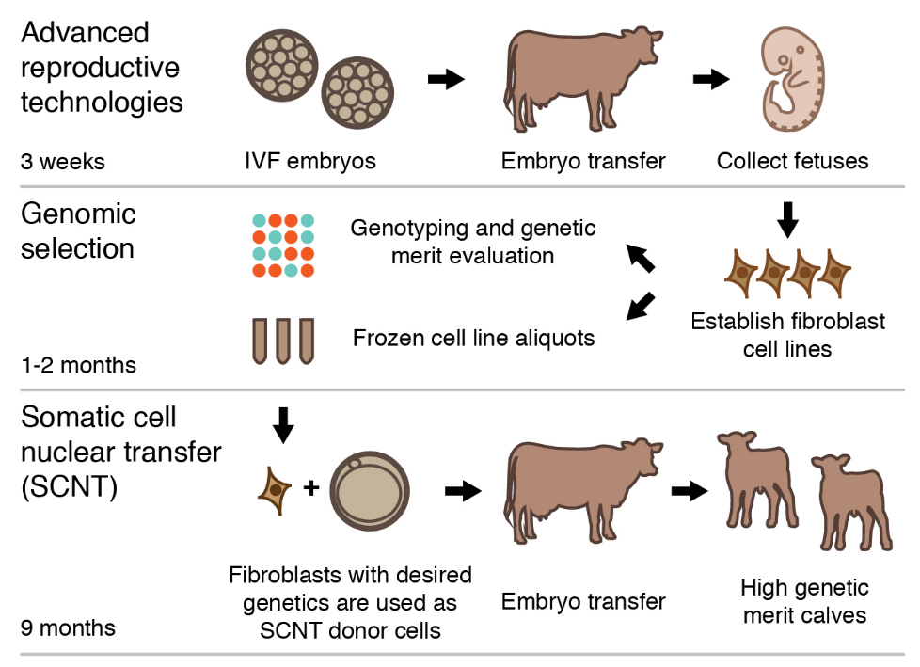
Cloning by somatic cell nuclear transfer
…
Mature technology
Affordable for high-value animals
Products from cloned animals cannot enter food-chain in the EU
Financial institutions may not support the technology
Source: Kasinathan et al., 2015, https://doi.org/10.1038/srep08674.
Cole – breed4food – May 2, 2024 - ‹#›

Slide 17
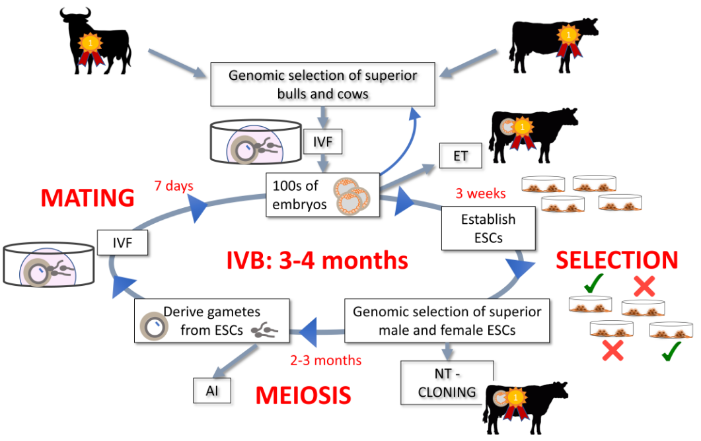
In vitro breeding
Technology not yet shown
to work in cattle
Animals might be classified
as genetically modified
Potential to double (or more) rates of genetic gain`
Source: Goszczynski et al., 2019, https://doi.org/10.1093/biolre/ioy256.
Cole – breed4food – May 2, 2024 - ‹#›

Slide 18
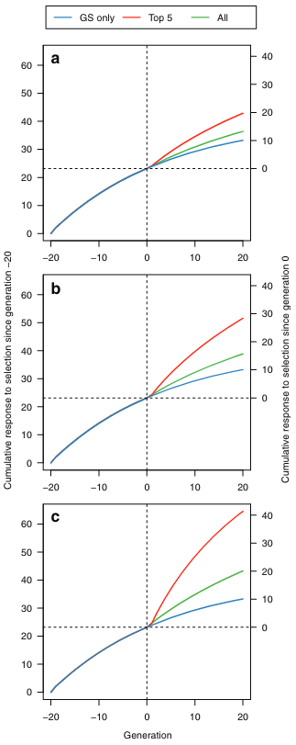
Promotion of alleles by gene editing
The current record for a live calf is 4 stacked
edits (T.S. Sonstegard, personal communication)
Those who dislike cloning REALLY dislike
gene editing
Can use in concert with RAGE (Johnsson et al.,
2019) to address concerns about genetic load
Source: Jenko et al., 2015, https://doi.org/10.1186/s12711-015-0135-3.
Cole – breed4food – May 2, 2024 - ‹#›

Slide 19
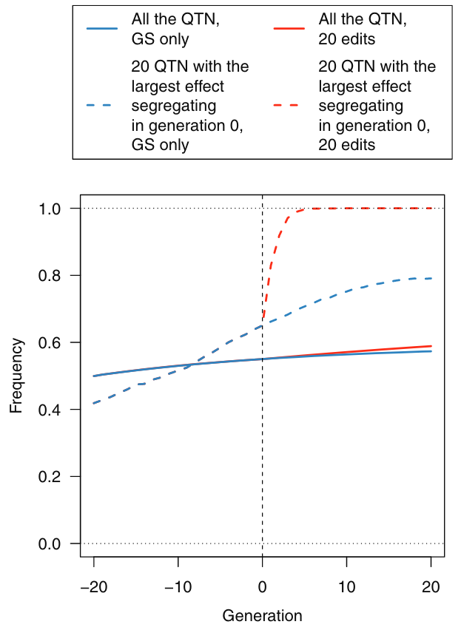
The goal is to eliminate genetic variation
If we fix all of the desirable alleles and
eliminate the undesirable alleles, we
maximize genetic potential
(This Cole’s proposal, not Jenko et al.)
See also Cole (2024) and Cole &
VanRaden (2011)
Source: Jenko et al., 2015, https://doi.org/10.1186/s12711-015-0135-3.
Cole – breed4food – May 2, 2024 - ‹#›

Slide 20
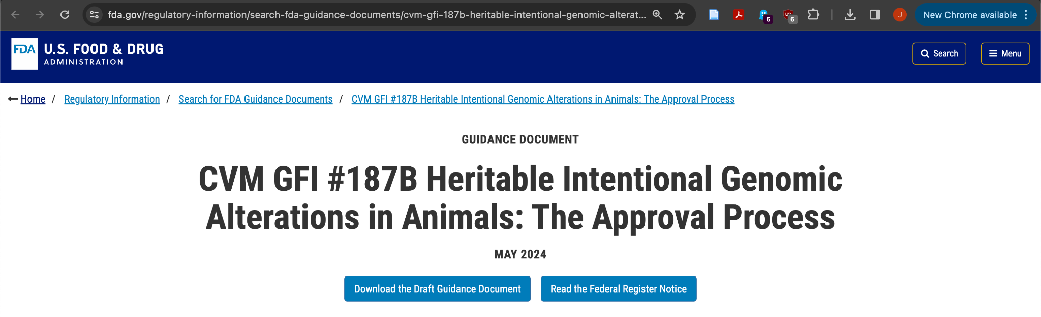
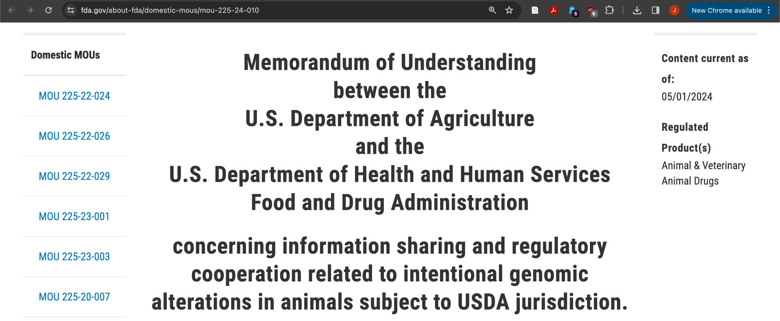
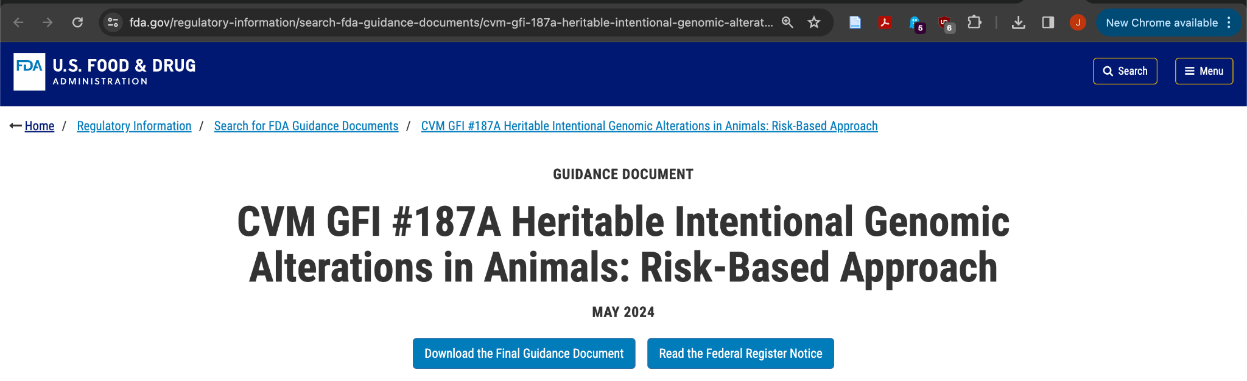
Regulatory changes enable market access
Cole – breed4food – May 2, 2024 - ‹#›

Slide 21
What if animals were irrelevant?
Question 4

Slide 22
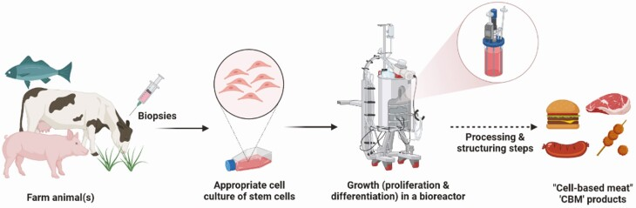
If you don’t need animals, you don’t need animal breeders
Source: Wood et al., 2023, https://doi.org/10.1093/af/vfac092.
Cole – breed4food – May 2, 2024 - ‹#›

Slide 23
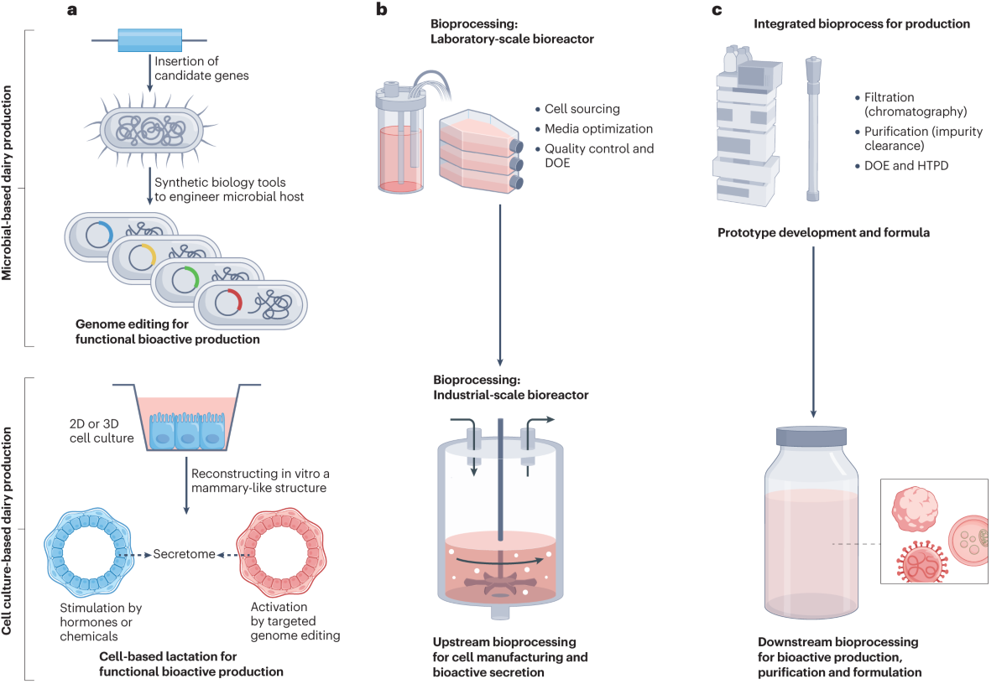
They can even make milk without cows!
Source: Yart et al., 2023, https://doi.org/10.1038/s44222-023-00112-x.
Cole – breed4food – May 2, 2024 - ‹#›

Slide 24
What does this mean for breeders?
Culture-based systems don’t require continuous genetic improvement for better product quality and production efficiency
These systems can be fed with cell-lines from contemporary genetics that are widely and cheaply available
Current business models are focused on production of individual animals, not effectively immortal cell-lines
If 1 million bioreactors were needed, that wouldn’t imply 1 million purchases of germplasm
Cole – breed4food – May 2, 2024 - ‹#›

Slide 25
What if North America and Europe were irrelevant?
Question 5

Slide 26
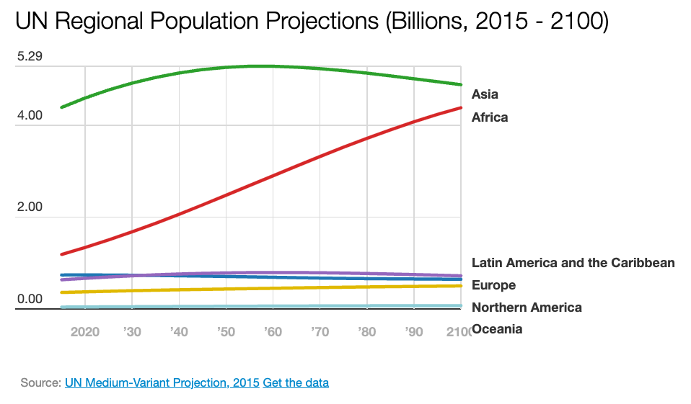
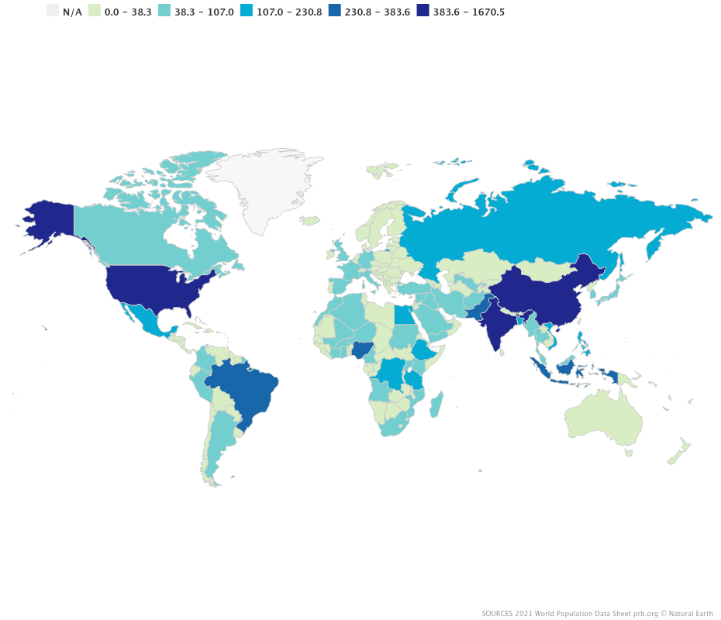
Birthrates are slowing or
declining in Western countries
Populations in Africa and Asia are growing much more quickly
Cole – breed4food – May 2, 2024 - ‹#›

Slide 27
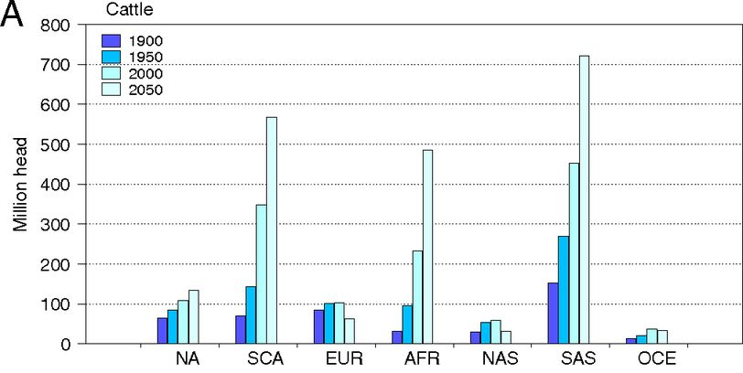
Where will the cows be in 2050?
Cattle populations will grow
substantially in South and
Central America, Africa, and
South Asia.
Modest gains in efficiency will
increase dietary quality.
Why should those consumers
care about our fear of biotechnology? Our kids aren’t going to bed hungry.
Source: Bouwman et al., 2013, https://doi.org/10.1073/pnas.1012878108.
Cole – breed4food – May 2, 2024 - ‹#›

Slide 28
Will Western genetics remain dominant?
Canada, the USA, and many European countries have extensive systems for animal data recording and development of elite germplasm
Many low- and middle-income countries have struggled to build out similar infrastructure
As their populations grow and economic prosperity increases there will be greater demand for more animal protein, including both meat and milk
Digital technologies may allow emerging industries to quickly develop new infrastructure, similar to the adoption of cellular phones in much of Africa
Cole – breed4food – May 2, 2024 - ‹#›

Slide 29
Conclusions

Slide 30
What does this all mean?
Animal breeding has been extremely successful, but we’re making many questionable assumptions about the future
While animal breeders don’t set policy, and can’t force retailers and consumers to accept any particular technology, we’re still assuming that our interests are aligned
Increased demand for animal protein in human diets is going to interact with stresses caused by global climate change in ways we can’t predict
We’ll struggle to remain relevant to other parts of the world
Cole – breed4food – May 2, 2024 - ‹#›

Slide 31
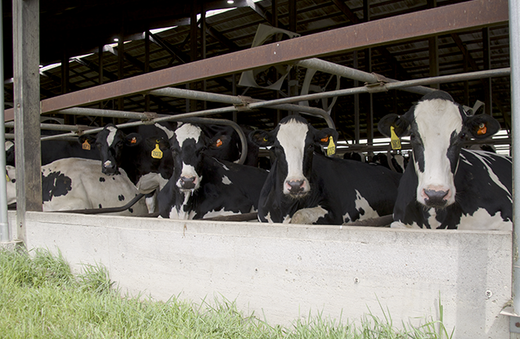
Conclusions
Animal breeding has been extremely successful in many species
Genomic selection has further increased
rates of gain
New tools – biotechnology, high-
throughput phenotyping, etc. – show
potential for even greater responses
Will you choose to take advantage of
those opportunities?
Cole – breed4food – May 2, 2024 - ‹#›

Slide 32
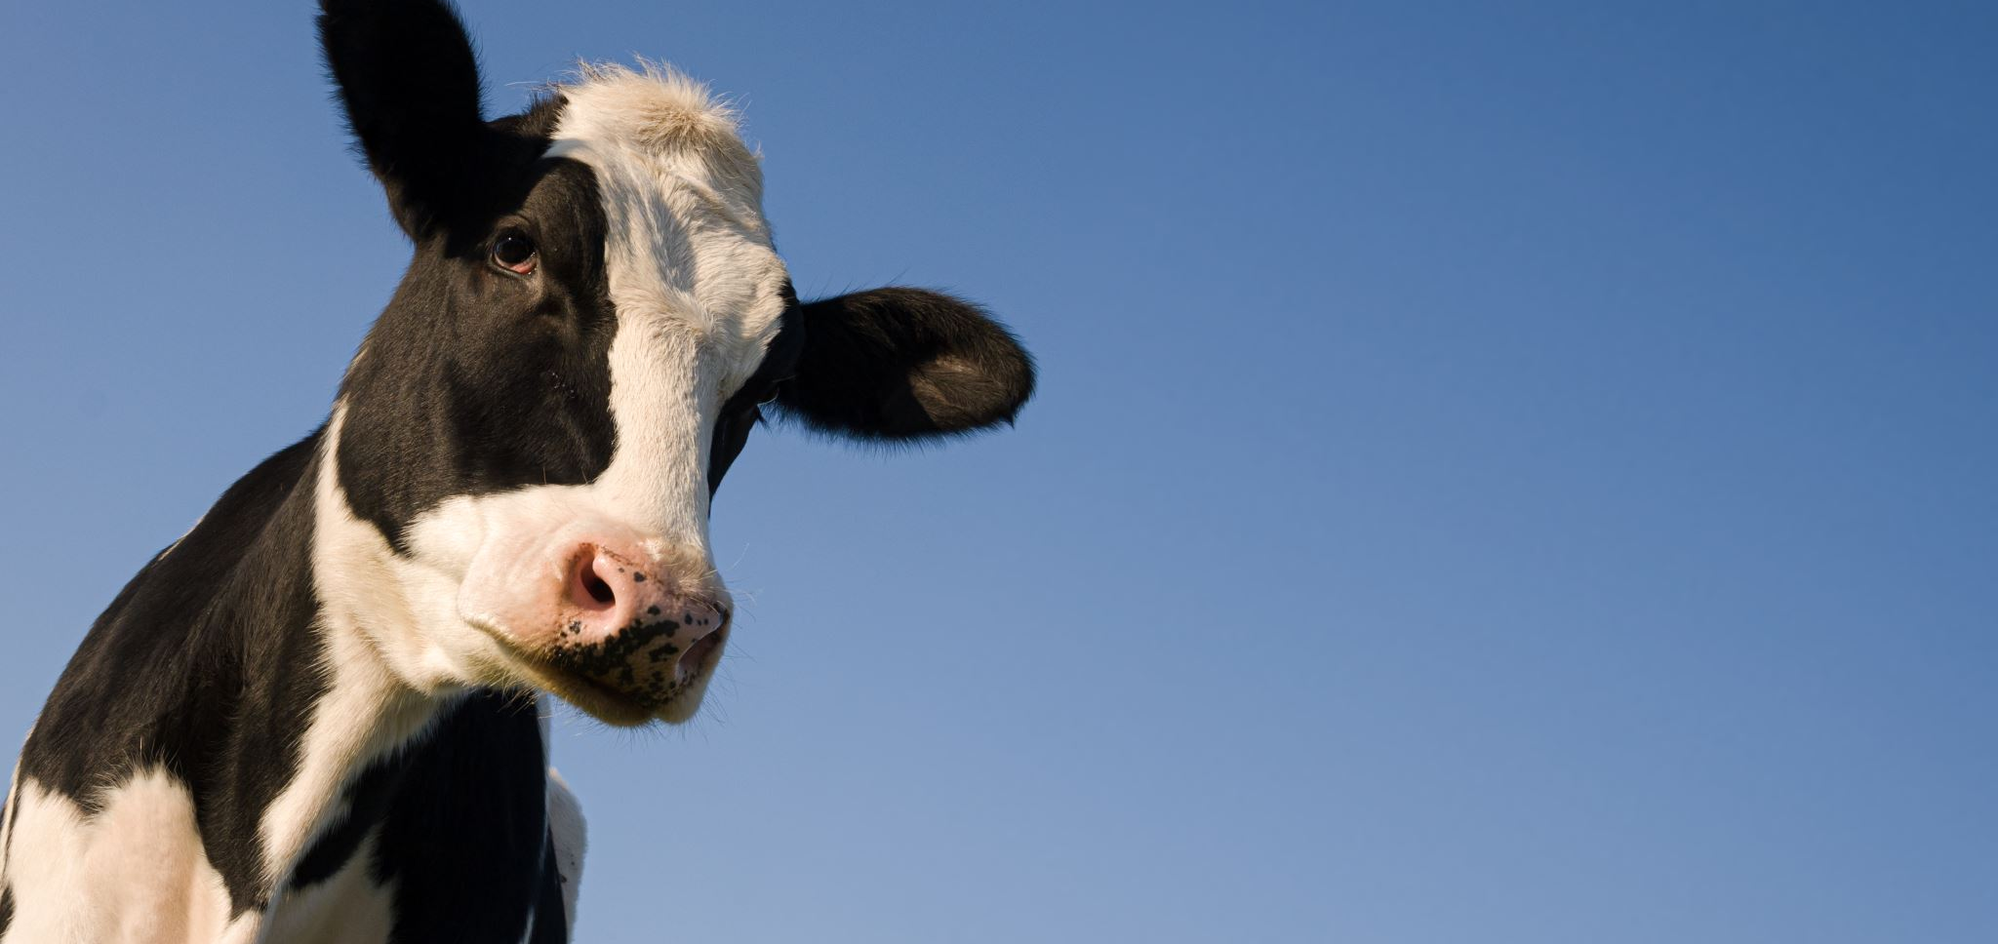
THANK YOU FOR YOUR ATTENTION!
QUESTIONS?
Cole – breed4food – May 2, 2024 - ‹#›

Slide 33
References
Bouwman, L., K.K. Goldewijk, K.W. Van Der Hoek, A.H.W. Beusen, D.P. Van Vuuren, J. Willems, M.C. Rufino, and E. Stehfest. 2013. Exploring global changes in nitrogen and phosphorus cycles in agriculture induced by livestock production over the 1900–2050 period. Proc. Natl. Acad. Sci. USA. 110:20882–20887. https://doi.org/10.1073/pnas.1012878108.
Cole, J.B. 2024. Perspective: Can we actually do anything about inbreeding? J. Dairy Sci. 107:643–648. https://doi.org/10.3168/jds.2023-23958.
Cole, J.B., and P.M. VanRaden. 2011. Use of haplotypes to estimate Mendelian sampling effects and selection limits. J. Anim. Breed. Genet. https://doi.org/10.1111/j.1439-0388.2011.00922.x.
Goszczynski, D.E., H. Cheng, S. Demyda-Peyrás, J.F. Medrano, J. Wu, and P.J. Ross. 2018. In vitro breeding: application of embryonic stem cells to animal production. Biolo. Reprod. https://doi.org/10.1093/biolre/ioy256.
Hansen, P.J., and J. Block. 2004. Towards an embryocentric world: the current and potential uses of embryo technologies in dairy production. Reprod. Fertil. Dev. 16:1–14. https://doi.org/10.1071/RD03073.
Cole – breed4food – May 2, 2024 - ‹#›

Slide 34
References
Hodgson, R.E. 1956. Dairy Production Research in the United States Department of Agriculture. J. Dairy Sci. 39:674–682. https://doi.org/10.3168/jds.S0022-0302(56)91188-2.
Jenko, J., G. Gorjanc, M.A. Cleveland, R.K. Varshney, C.B.A. Whitelaw, J.A. Woolliams, and J.M. Hickey. 2015. Potential of promotion of alleles by genome editing to improve quantitative traits in livestock breeding programs. Genet Sel Evol 47:1–14. https://doi.org/10.1186/s12711-015-0135-3.
Johnsson, M., R.C. Gaynor, J. Jenko, G. Gorjanc, D.-J. de Koning, and J.M. Hickey. 2019. Removal of alleles by genome editing (RAGE) against deleterious load. Genet. Sel. Evol. 51:14. https://doi.org/10.1186/s12711-019-0456-8.
Kasinathan, P., H. Wei, T. Xiang, J.A. Molina, J. Metzger, D. Broek, S. Kasinathan, D.C. Faber, and M.F. Allan. 2015. Acceleration of genetic gain in cattle by reduction of generation interval. Sci. Rep. 5:srep08674. https://doi.org/10.1038/srep08674.
Miles, A.M., J.L. Hutchison, and P.M. VanRaden. 2023. Improving national fertility evaluations by accounting for the rapid rise of embryo transfer in US dairy cattle. J. Dairy Sci. 106:4836–4846. https://doi.org/10.3168/jds.2022-22298.
Cole – breed4food – May 2, 2024 - ‹#›

Slide 35
References
Wall, R.J., A.M. Powell, M.J. Paape, D.E. Kerr, D.D. Bannerman, V.G. Pursel, K.D. Wells, N. Talbot, and H.W. Hawk. 2005. Genetically enhanced cows resist intramammary Staphylococcus aureus infection. Nature Biotech. 23:445–451. https://doi.org/10.1038/nbt1078.
Wood, P., L. Thorrez, J.-F. Hocquette, D. Troy, and M. Gagaoua. 2023. “Cellular agriculture”: current gaps between facts and claims regarding “cell-based meat”. Anim. Front. 13:68–74. https://doi.org/10.1093/af/vfac092.
Yart, L., A.W. Wijaya, M.J. Lima, C. Haller, E.M. van der Beek, R.S. Carvalho, M.R.-C. Kraus, and O. Mashinchian. 2023. Cellular agriculture for milk bioactive production. Nat. Rev. Bioeng. 1:858–874. https://doi.org/10.1038/s44222-023-00112-x.
Cole – breed4food – May 2, 2024 - ‹#›

